Slide 1

Citation Network
Analysis
Who matters most?
Introduction to Network Science
Your Name • Student ID
OpenAlex • Python • NetworkX • Due 28 October 2026

Slide 2
Who matters most — and by which definition?
MAIN QUESTION
Q1
In-degree
Q3
PageRank
Which papers are most important
inside this citation network?
Q2
Betweenness
Q4
Communities
Q5 Rankings over time (up to 2010 vs full)

Slide 3
A closed, reproducible sample
OpenAlex
5 title queries
Top 150
most-cited papers
Directed graph
in NetworkX
Centrality +
communities
Edge A → B: paper A cites paper B • 428 raw edges, 4 self-loops removed → 424 edges • retrieved 2026-10-20

Slide 4
The network is sparse but connected
133 of 150 papers in the largest component • 33% never cited in-sample • average path 2.92, diameter 7
150
424
1.90%
2.83
papers
citation edges
directed density
mean out-degree

Slide 5
Q1 — Classics win on in-degree
1973 co-citation paper leads with 41
RANK PAPER (YEAR) — IN-DEGREE
01 Co-citation in the scientific literature (1973) — 41
02 VOSviewer, a program for bibliometric mapping (2009) — 31
03 Bibliographic coupling between scientific papers (1963) — 18
04 Visualizing a discipline: author co-citation analysis (1998) — 15
05 Citation Analysis as a Tool in Journal Evaluation (1972) — 12
06 Intellectual structure of strategic management research (2004) — 11
07 Toward a definition of “bibliometrics” (1987) — 10
08 Intellectual structure of the strategic management field (2007) — 10
09 Literature of Bibliometrics, Scientometrics, Informetrics (2001) — 8
10 Bibliometric Methods in Management and Organization (2014) — 8
Counts include only citations from the other 149 sampled papers.

Slide 6
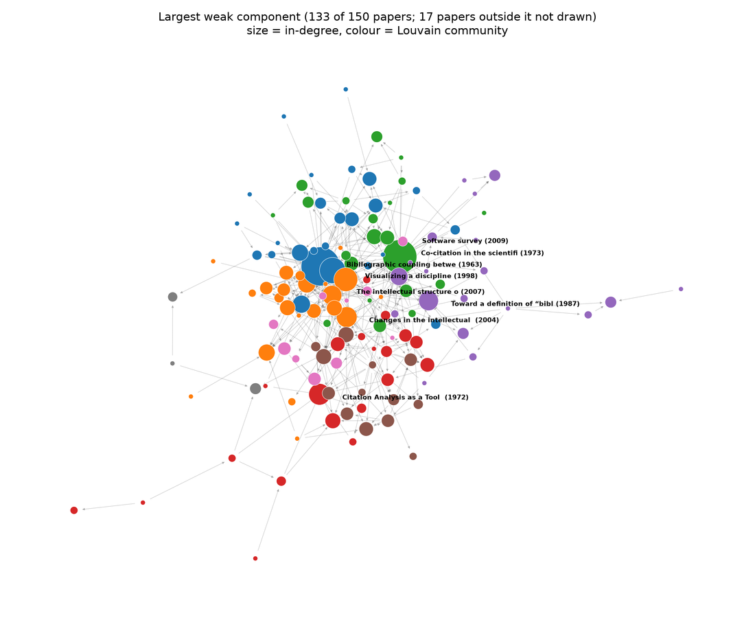
The network at a glance
Node size
In-degree
Node colour
Louvain community
Arrow
Citing → cited paper
Drawn: 133 of 150 papers
(17 outside the largest component are not shown)

Slide 7
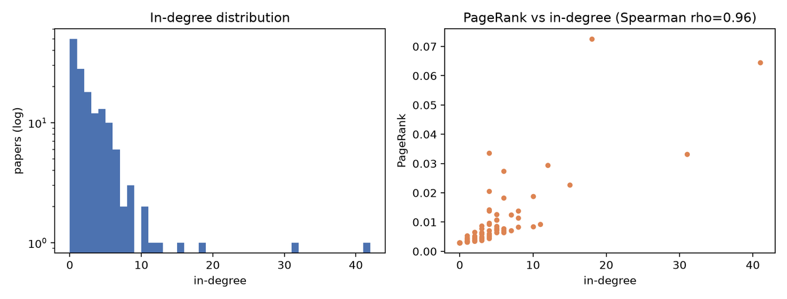
Q3 — PageRank agrees, then reorders
Strong agreement.
Different top.
Spearman ρ = 0.96, yet only 6 of the top 10 papers are shared. In-degree puts the 1973 co-citation paper first; PageRank puts the 1963 bibliographic coupling paper first, because it is cited by well-cited papers.

Slide 8
Q2 — Bridges are not always classics
High betweenness belongs to recent reviews and method papers that connect otherwise separate conversations.
01 How to conduct a bibliometric analysis: overview and guidelines (2021) — 0.0109
02 Bibliometric Methods in Management and Organization (2014) — 0.0071
03 Scholarly communication and bibliometrics (2002) — 0.0071
04 The intellectual structure of the strategic management field (2007) — 0.0052
05 Changes in the intellectual structure of strategic management research (2004) — 0.0045
Foundational papers are cited heavily but sit at path endpoints, so their betweenness is low.

Slide 9
Q4 — The field has moderate community structure
Louvain on the undirected graph • seed 42 • 24 communities • modularity 0.42
21 papers
VOSviewer (2009)
Largest four communities, labelled by their top paper. Seven communities have 10 or more papers; the rest are small groups or papers with no in-sample links.
25 papers
Co-citation (1973)
20 papers
Journal evaluation (1972)
22 papers
Author co-citation (1998)

Slide 10
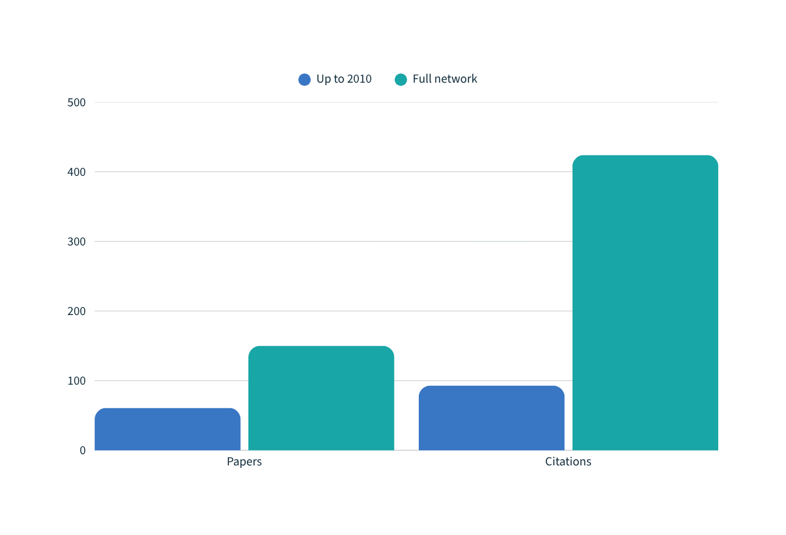
Q5 — Importance changes as the network grows
Snapshot comparison
Up to 2010
61 papers
93 citations
Full network
150 papers
424 citations
The 1973 co-citation paper is #1 in both networks (in-degree 14 → 41). Others fall: Scholarly communication and bibliometrics #4 → #14, Problems of citation analysis #6 → #30.

Slide 11
What this sample can—and cannot—say
CAN SAY
CANNOT SAY
Which papers are central inside this closed 150-paper network.
How three centrality measures behave on the same graph.
Who matters across all of bibliometrics: OpenAlex coverage and title-keyword sampling limit this.
Total citation counts: in-degree counts only the other 149 papers.
Quality: citations measure attention, not quality.
Also: older papers had longer to be cited (ρ year vs in-degree = −0.61) • self-citations not removed • Louvain seed fixed at 42 • 2010 cutoff is a choice

Slide 12
Who matters most depends on the measure
IN-DEGREE
1973 co-citation paper (41)
BETWEENNESS
2021 guidelines paper
PAGERANK
1963 coupling paper first
PageRank tracks in-degree (ρ = 0.96) but reorders the top. Citation counts show attention, not quality.

Slide 13
References and code
KEY REFERENCES
REPRODUCIBLE WORKFLOW
OpenAlex documentation. Works and referenced works.
NetworkX documentation. Centrality algorithms.
Blondel et al. (2008). Fast unfolding of communities.
Small (1973). Co-citation in the scientific literature.
collect.py fetch OpenAlex
analyze.py metrics + communities
build_deck.py slides
results/ tables + figures
Python • NetworkX • pandas
github.com/MSamiulHasnat/CitationNetworkAnalysis
Questions?

